Slide 1
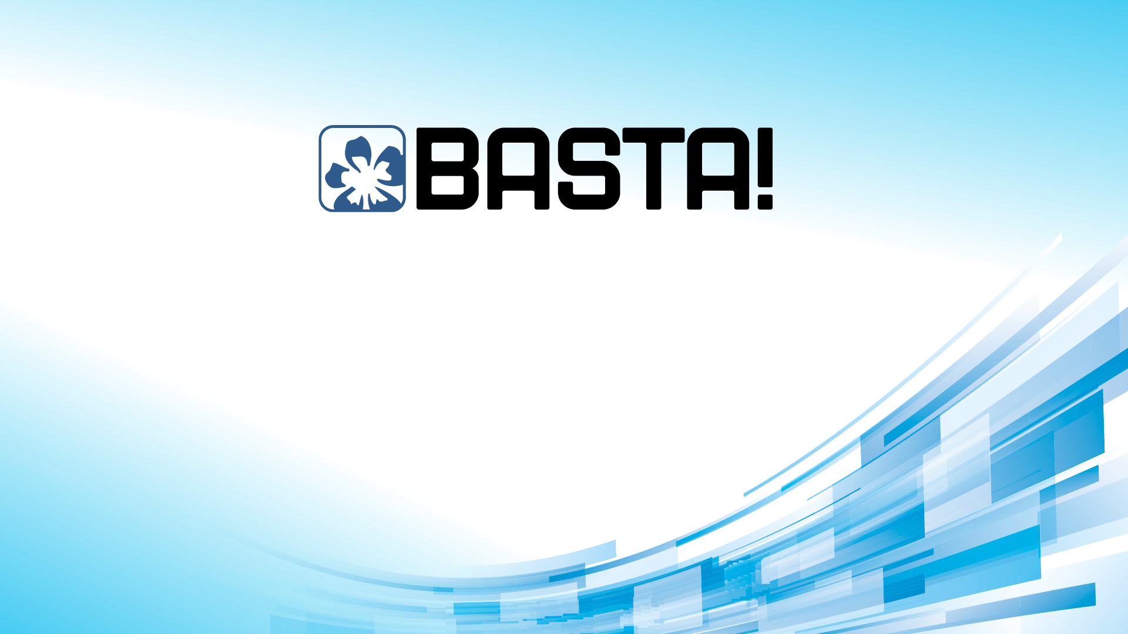
100 machines do 100s work in 1s From 0 to 100 Containers with .NET Core and Azure Serverless Containers with Azure, Containers Instances & Apps
100 machines do 100s work in 1s From 0 to 100 Containers with .NET Core and Azure Serverless Containers with Azure, Containers Instances & Apps
Roberto Freato – Azure MVP / CTO @Witailer
Roberto Freato – Azure MVP / CTO @Witailer

Slide 2
compute quadrant (2021)
Notes:
Budget – 5min
How to read this quadrant and how’s made
Information is accurate but personal
Scale may depends on soft or hard limits of the platform
Examples of soft and hard limits
Ease of management can be the degree of interest we need to have to the underlying infrastructure
Or either the lock-in aspect
Or the industry-standard adherence

Slide 3
compute quadrant (today)
Container Apps
Notes:
Budget – 5min
How to read this quadrant and how’s made
Information is accurate but personal
Scale may depends on soft or hard limits of the platform
Examples of soft and hard limits
Ease of management can be the degree of interest we need to have to the underlying infrastructure
Or either the lock-in aspect
Or the industry-standard adherence

Slide 4
My personal timeline for scalable processing
App Service
Batch
Container Instances
Container Apps

Slide 5
Demo
Producer + Consumer:
On Azure Container Instances (with Manual scale)
On Azure Container Apps (with Autoscale)

Slide 6
Takeaways
Container Instances and Container Apps are both serverless
Think as Container Apps as an ACI «v2»
Container Apps will activate on demand (idle mode + 0-scale) AND:
Dapr native integration
KEDA-based event-driven autoscaling

Slide 7
100 machines do 100s work in 1s From 0 to 100 Containers with .NET Core and Azure Serverless Containers with Azure, Containers Instances & Apps
100 machines do 100s work in 1s From 0 to 100 Containers with .NET Core and Azure Serverless Containers with Azure, Containers Instances & Apps
Roberto Freato – Azure MVP / CTO @Witailer
Roberto Freato – Azure MVP / CTO @Witailer

